Slide 1
Data wrangling and Feature Engineering
Lecture -9
Sumita Narang

Slide 2
Objectives
Data cleaning
Data Integration/ Aggregation
Data Sampling
Handling Numeric Data
Discretization, Binarization
Normalization
Data Smoothening
Managing Categorical Attributes
Transforming Categorical to Numerical Values
Encoding techniques
Dealing with textual Data
Data Similarity
Feature Engineering
Feature Extraction (Dimensionality Reduction)
Feature Construction
Feature Subset selection
Filter methods
Wrapper methods
Embedded methods
Feature Learning
Case Study involving FE tasks

Slide 3
Handling Categorical Data
Source Courtesy: Some of the contents of this PPT are sourced from materials provided by publishers of prescribed books

Slide 4
Learning Objectives
Articulate the need for categorical encoding
List and define various data encoding methods
Make the calculations that are necessary to get meaningful encodings

Slide 5
Four Levels of data
Used for names or label a series of values.
Ex: Gender(dichotomous),Hair color, Country names
Ordinal values represent discrete and ordered units.
Ex: Shirt size, letter grades, food quality
Nominal
Categorical
(qualitative)
Ordinal
Data
Interval
Numerical
(quantitative)
Interval values represent ordered units that have the same difference.
Ex: temperature of a given place
Ratio values represent ordered units that have the same difference. There’s a value that means “nothing/none.”
Ex: Age, weight, test score
Ratio

Slide 6
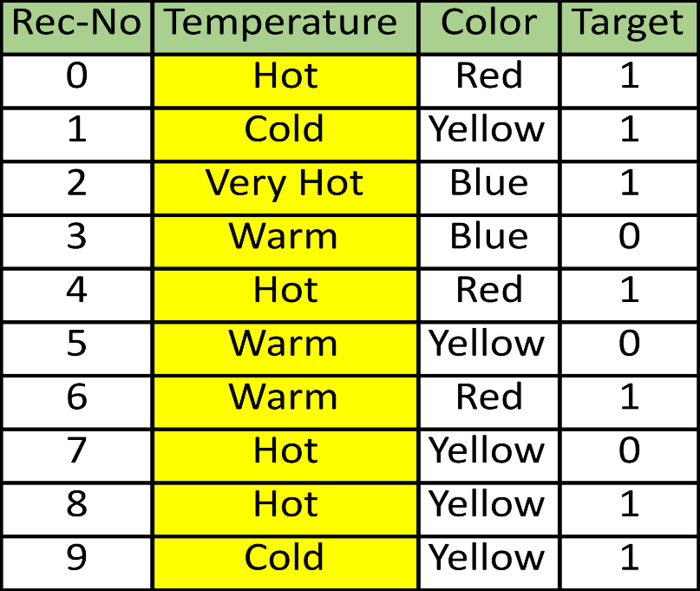
Categorical Encoding
Defined
Categorical encoding refers to replacing the category strings by a numerical representation
The goal of categorical encoding is:
To build predictive features from categories
To produce variables that can be used to train machine learning models
https://towardsdatascience.com/all-about-categorical-variable-encoding-305f3361fd02

Slide 7
Categorical Encoding Techniques
Traditional
One hot encoding
Count / frequency encoding
Monotonic relationship
Ordered label encoding
Mean encoding
Alternatives
Binary encoding
Feature hashing
Label Encoding
Ordinal Encoding
Helmert Encoding
Frequency Encoding
Weight of Evidence Encoding
Probability Ratio Encoding
Backward Difference Encoding
Leave One Out Encoding
James-Stein Encoding
M-estimator Encoding

Slide 8
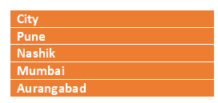
One hot encoding
One hot encoding, consists in encoding each categorical variable with a set of boolean variables which take values 0 or 1, indicating if a category is present for each observation.
Pune | Nashik | Mumbai | Aurangabad
1 | 0 | 0 | 0
0 | 1 | 0 | 0
0 | 0 | 1 | 0
0 | 0 | 0 | 1

Slide 9
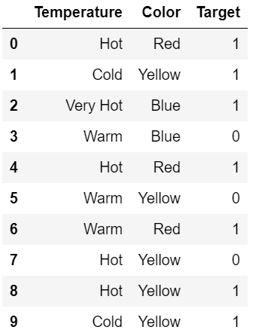
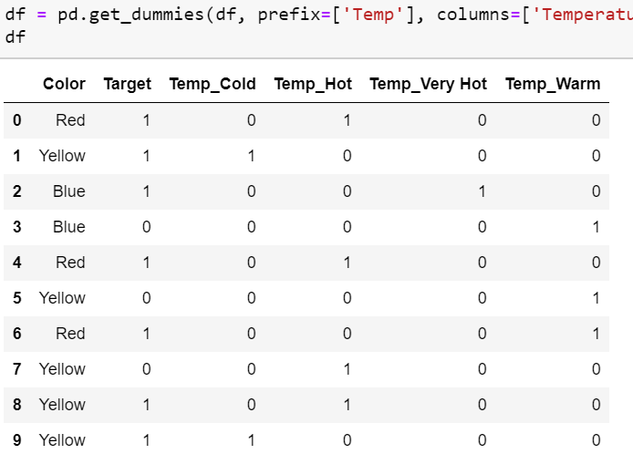
One hot Encoding (k Variables)

Slide 10
One hot encoding (k-1 variables)
Using “k-1” fields
More generally, a categorical variable should be encoded by creating k-1 binary variables, where k is the number of distinct categories.
In the case of binary variables, like gender where k=2 (male / female)we need to create only 1 (k - 1 = 1) binary variable.
One hot encoding into k-1 binary variables takes into account that we can use 1 less dimension and still represent the whole information:
if the observation is 0 in all the binary variables, then it must be 1 in the final (not present) binary variable.
Pune | Nashik | Mumbai
1 | 0 | 0
0 | 1 | 0
0 | 0 | 1
0 | 0 | 0

Slide 11
One hot encoding into k -1 variables
Most machine learning algorithms, consider the entire data set while being fit.
Therefore, encoding categorical variables into k - 1 binary variables, is better, as it avoids introducing redundant information.

Slide 12
One hot encoding into k variables
There are a few occasions when it is better to encode variables into k dummy variables:
when building tree based algorithms
when doing feature selection by recursive algorithms
when interested in determine the importance of each single category

Slide 13
One hot encoding: Advantages & Disadvantages
Advantages
Makes no assumption about the distribution or categories of the categorical variable
Keeps all the information of the categorical variable
Suitable for linear models
Disadvantages
Expands the feature space
Does not add extra information while encoding
Many dummy variables may be identical, introducing redundant information

Slide 14
Label / integers encoding
Defined
Integer encoding consist in replacing the categories by digits from 1 to n (or 0 to n-1, depending the implementation), where n is the number of distinct categories of the variable.
The numbers are assigned arbitrarily.
This encoding method allows for quick benchmarking of machine learning models.
City
Pune
Nashik
Mumbai
Aurangabad
City
1
2
3
4

Slide 15
Label / integers encoding (2)
Advantages and Limitations
Advantages
Straightforward to implement
Does not expand the feature space
Can work well enough with tree based algorithms
Limitations
Does not add extra information while encoding
Not suitable for linear models
Does not handle new categories in test set automatically

Slide 16
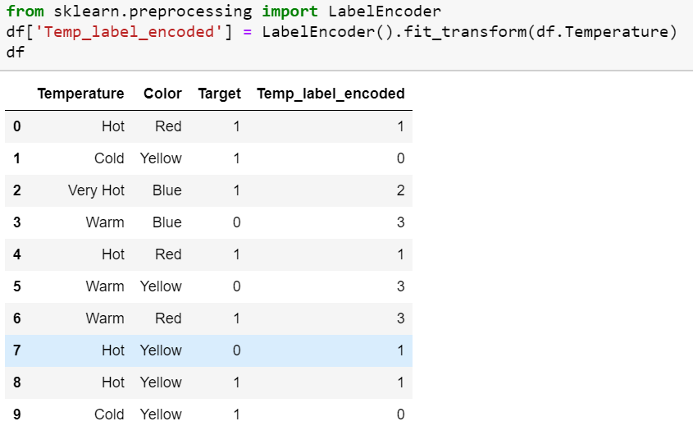
Example

Slide 17
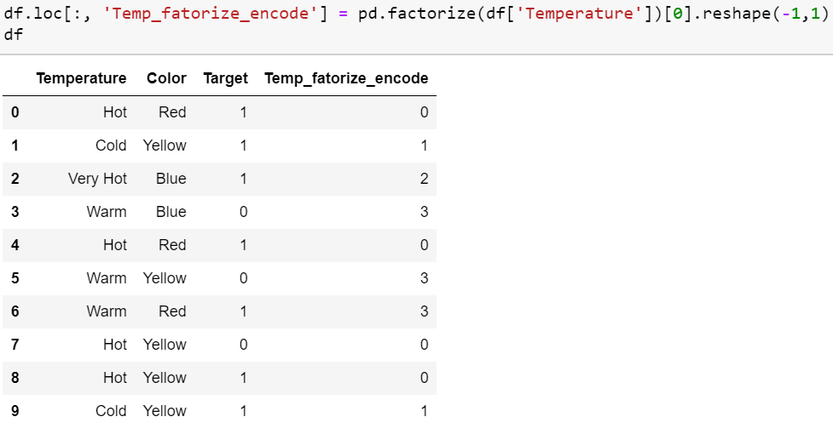
Example

Slide 18
Count / frequency encoding
Defined
Categories are replaced by the count or percentage of observations that show that category in the dataset.
Captures the representation of each label in a dataset
Very popular encoding method in Kaggle competitions.
Assumption: the number observations shown by each category is predictive of the target.
Count Encoding
Frequency Encoding
City
Pune
Nashik
Mumbai
Aurangabad
Pune
Mumbai
City
2
1
2
1
2
2
City
2 / 6 = 0.33
1 / 6 = 0.166
2 / 6 = 0.33
1 / 6 = 0.166
2 / 6 = 0.33
2 / 6 = 0.166

Slide 19
Count / frequency encoding (2)
Advantage / Limitations
Advantages
Straightforward to implement
Does not expand the feature space
Can work well enough with tree based algorithms
Limitations
Not suitable for linear models
Does not handle new categories in test set automatically
If 2 different categories appear the same amount of times in the dataset, that is, they appear in the same number of observations, they will be replaced by the same number:
may lose valuable information.

Slide 20
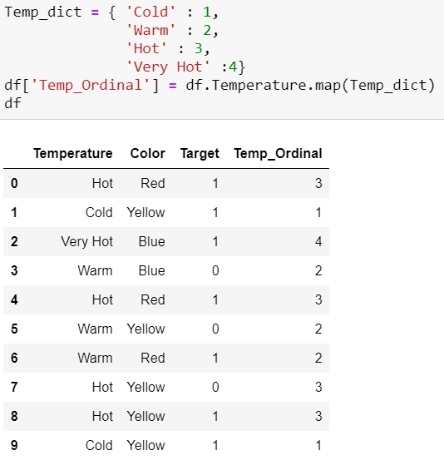
Ordinal Encoding
Ordinal encoding is done to ensure encoding of variable retains ordinal nature of the variable. This is reasonable only for ordinal variables as I mentioned in the beginning of this article. This encoding looks almost similar to Label Encoding but slightly different as Label coding would not consider whether variable is ordinal or not and it will assign sequence of integers
as per the order of data (Pandas assigned Hot (0), Cold (1) , “Very Hot” (2) and Warm (3)) or
as per alphabetical sorted order (scikit-learn assigned Cold(0), Hot(1) , “Very Hot” (2) and Warm (3)) .

Slide 21
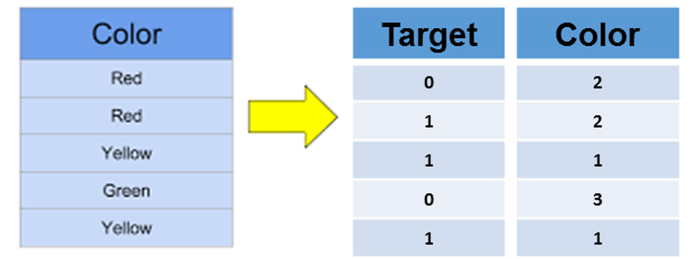
Ordered ordinal encoding
Defined
Categories are replaced by integers from 1 to k, where k is the number of distinct categories in the variable, but this numbering is informed by the SUM of the target for each category
Note- Feature Category with smallest sum of targets, gets highest order number; while the category with largest sum of targets, gets the lowest order number. Reason: Optimal in memory
0+1
0+1
1+1
0
1+1

Slide 22
Ordered ordinal encoding (2)
Advantages & Limitations
Advantages
Straightforward to implement
Does not expand the feature space
Creates monotonic relationship between categories and target
Limitations
May lead to over-fitting
Difficult to implement together with cross validation with current libraries

Slide 23
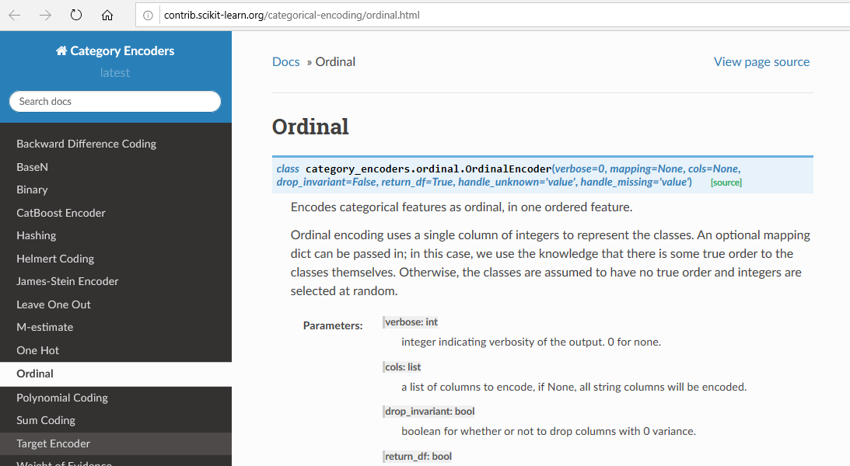
Ordered ordinal encoding (3)

Slide 24
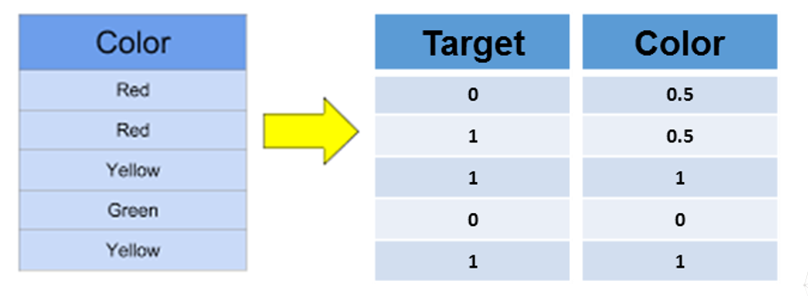
Mean or Target encoding
Defined
Mean encoding implies replacing the category by the average target value for that category
0+1
0+1
1+1
0
1+1

Slide 25
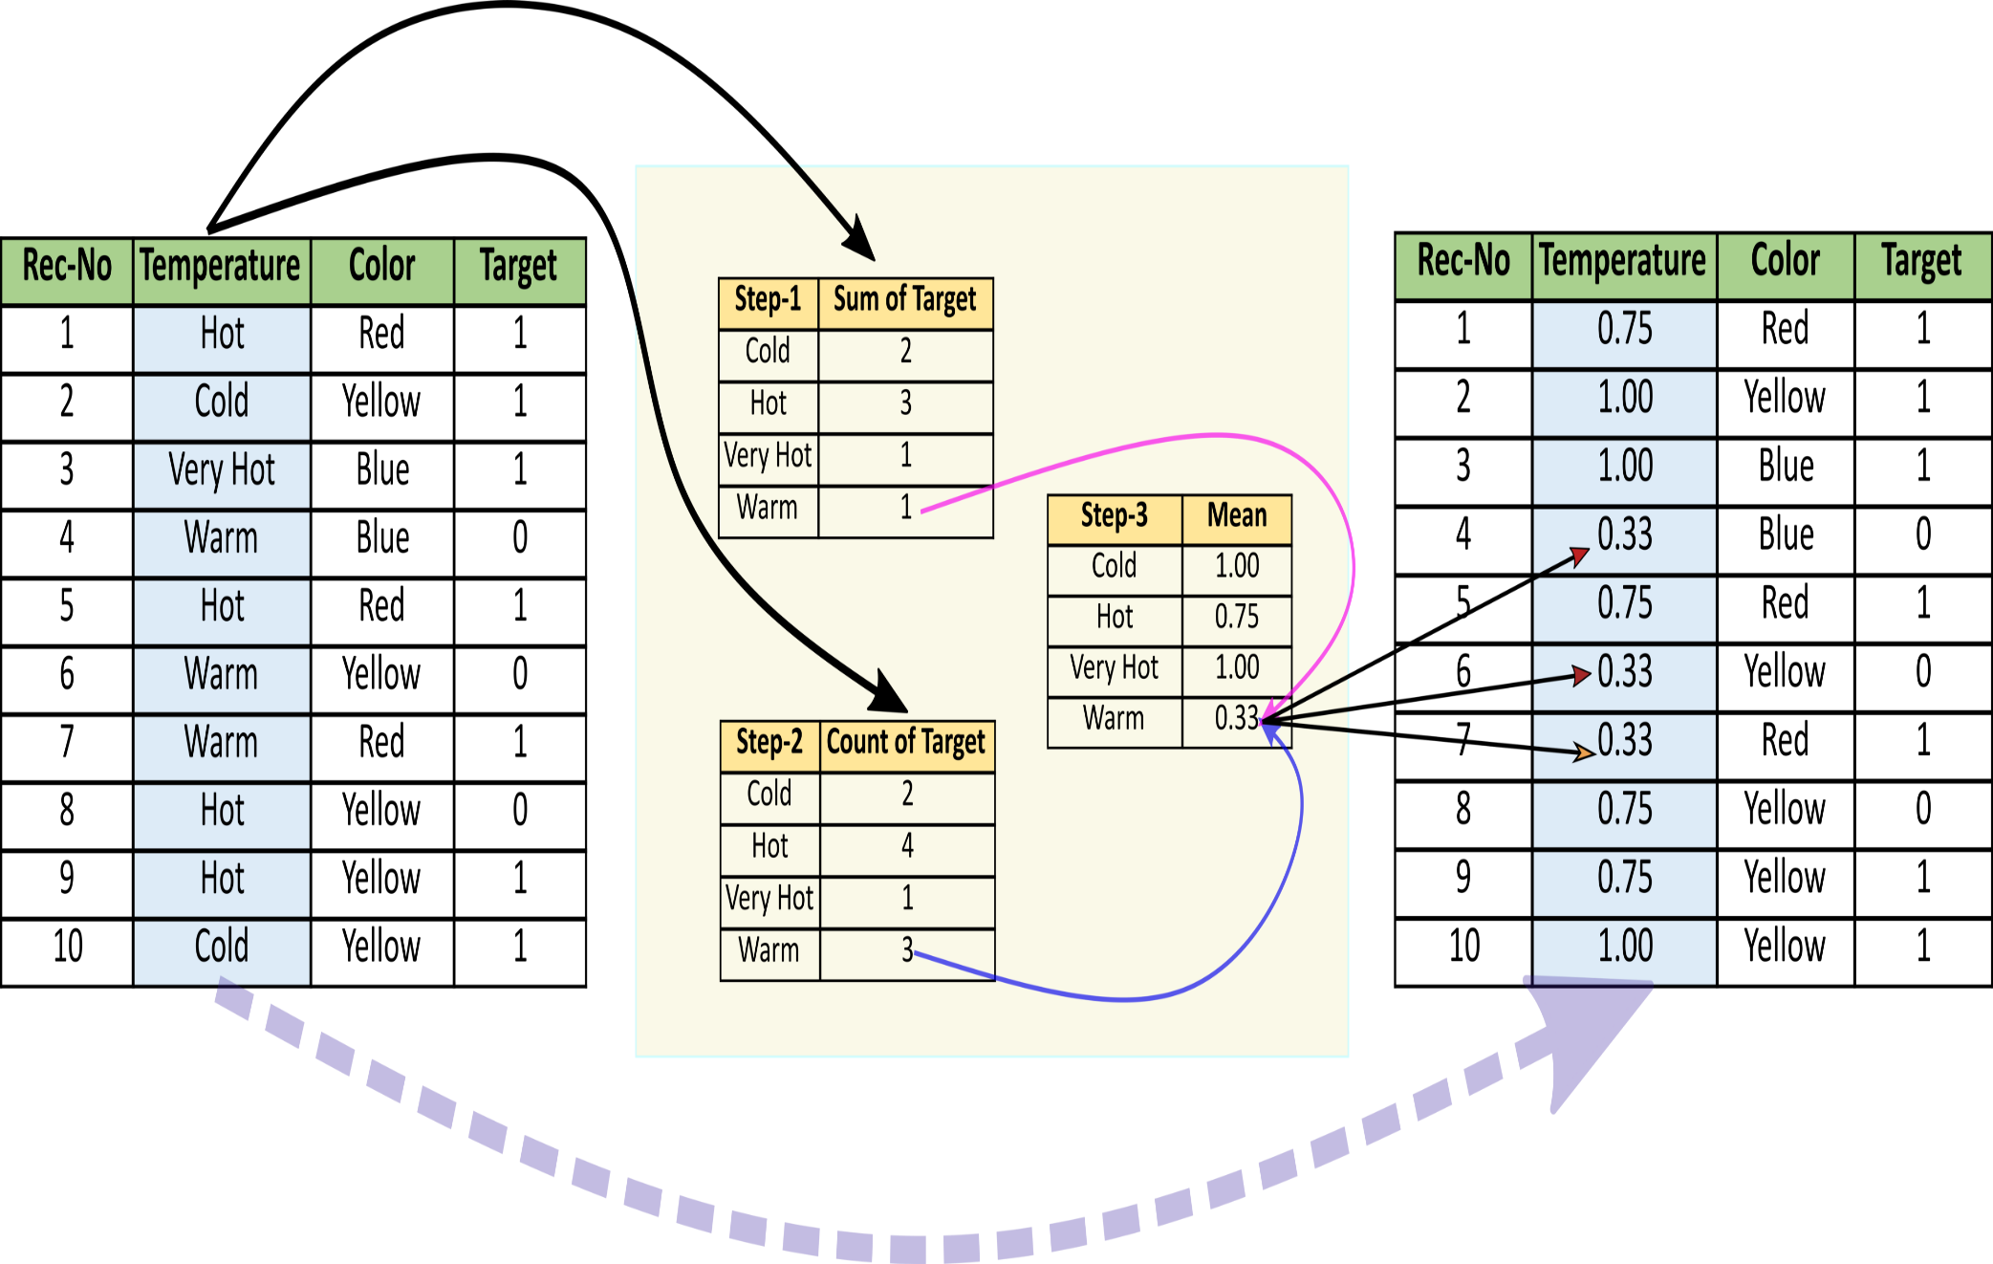
Example

Slide 26
Mean or target encoding (2)
Advantages and Limitations
Advantages
Straightforward to implement
Does not expand the feature space
Creates monotonic relationship between categories and target
Limitations
May lead to over-fitting
Difficult to implement together with cross-validation with current libraries
If 2 categories show the same mean of target, they will be replaced by the same number => potential loss of value

Slide 27
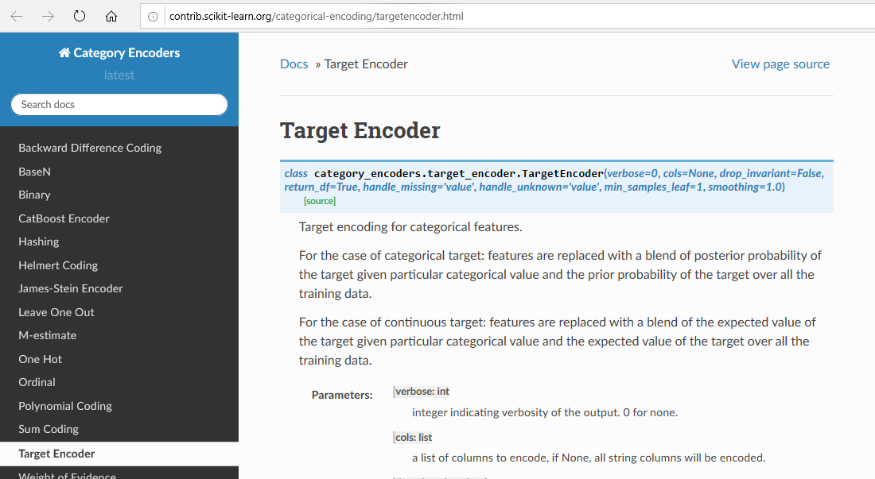
Mean or target encoding (3)

Slide 28
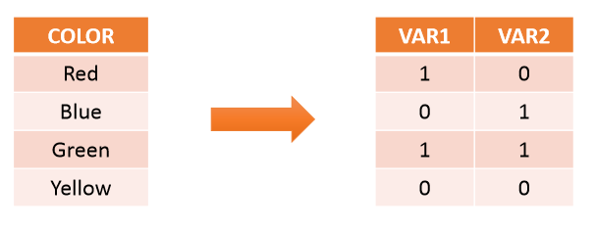
Binary encoding
Definition
Use binary code, a collection of 0s and 1s, to encode the meaning of the variable.
Individually derived variable lack human readable meaning.

Slide 29
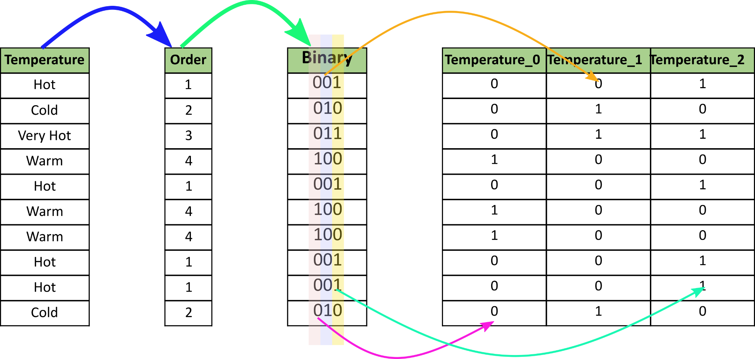
Example

Slide 30
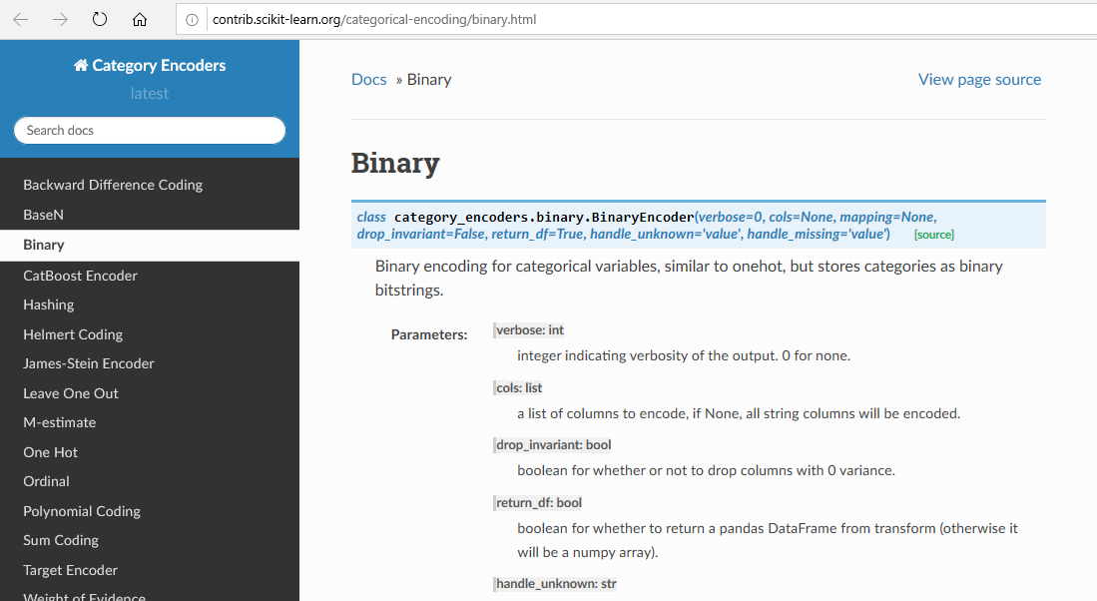
Binary encoding (2)

Slide 31
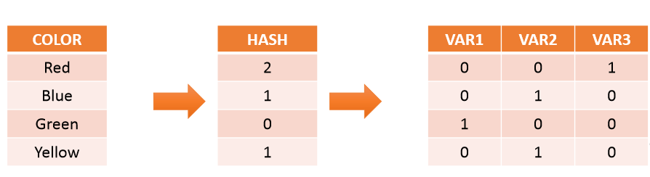
Feature Hashing
Defined
Use a hashing method, any of choice, to encode the variables
May lead to different labels taking the same value

Slide 32
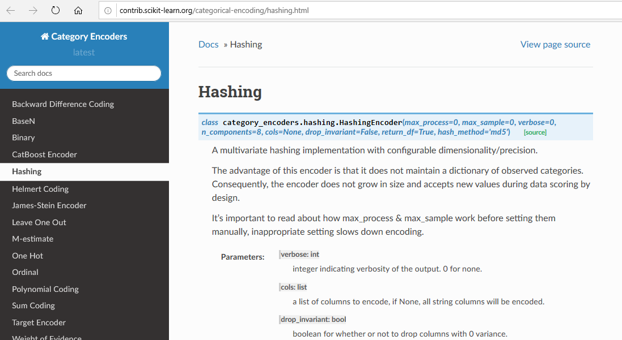
Feature Hashing (2)

Slide 33
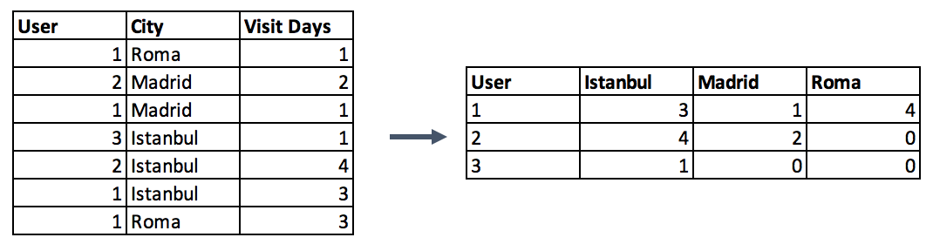
Categorical Column Grouping
3 different ways for aggregating categorical columns:
The first option is to select the label with the highest frequency. In other words, this is the max operation for categorical columns, but ordinary max functions generally do not return this value, you need to use a lambda function for this purpose.
data.groupby('id').agg(lambda x: x.value_counts().index[0])
Second option is to make a pivot table.
Last categorical grouping option is to apply a group by function after applying one-hot encoding. This method preserves all the data -in the first option you lose some-, and in addition, you transform the encoded column from categorical to numerical in the meantime.

Slide 34
Feature Split
Splitting features is a good way to make them useful in terms of machine learning. Most of the time the dataset contains string columns that violates tidy data principles. By extracting the utilizable parts of a column into new features:
We enable machine learning algorithms to comprehend them.
Make possible to bin and group them.
Improve model performance by uncovering potential information.
Split function is a good option
#String extraction example
data.title.head()
0 Toy Story (1995)
1 Jumanji (1995)
2 Grumpier Old Men (1995)
3 Waiting to Exhale (1995)
4 Father of the Bride Part II (1995)
data.title.str.split("(", n=1, expand=True)[1].str.split(")", n=1, expand=True)[0]
0 1995
1 1995
2 1995
3 1995
4 1995

Slide 35
Data Quality – Handling Missing Data

Slide 36
Learning objectives
Understanding reasons for missing values
Identify and impute missing values
List different type Imputation techniques
Choose appropriate techniques to impute missing values

Slide 37

Major issue with real word data sets
Real world data is often dirty

Slide 38
Missing data
Customer Name | Age | Income
Rahul | 35 | 12,00,000
Shravya | -- | 8,00,000
Mehul | 40 | 22,00,000
Vaishali | 25 | --
Shiva | 65 | --

Slide 39
Impact of Missing data
Incompatible in Scikitlearn
Missing data imputation may distort variable distribution
Affect the performance of Machine Learning Models

Slide 40

Missing Data : Mechanism
Understanding the mechanism of missing data will help us choose appropriate imputation method.
Missing completely at random (MCAR)
Missing at random (MAR)
Not missing at random (NMAR):

Slide 41
Missing completely at random (MCAR)
The probability of missing is same for all the observations.
There is no relationship between the missing values and any other values in the dataset.
Removing such missing values will not effect the inferences made.

Slide 42
Missing Data at Random(MAR)
Gender | Age
Male | 42
Male | NA
Male | 24
Male | NA
Male | 36
Male | 57
Female | 32
Female | NA
Female | NA
Female | 18
Female | NA
Female | 23
The probability of a missing values depends on available information i.e it depends on other variables in the dataset.
33% males
50% Females

Slide 43
Missing Data Not at Random(MNAR)
No of clinical visits | No of sports classes attended | Depression
1 | NA | Yes
NA | NA | Yes
NA | 0 | Yes
4 | 2 | Yes
NA | 1 | Yes
3 | NA | Yes
0 | 0 | No
NA | 5 | No
1 | 2 | No
1 | 1 | No
2 | 1 | No
NA | 2 | No
The missing values exist as an indication of a certain class.

Slide 44
Missing Values Handling
Techniques for Numerical and Categorical Data
Dropping missing values rows or columns; define a threshold e.g. 70% rows/columns with more than threshold missing values need to be dropped
Imputation – Missing data is imputed, preserves the data size
Numerical Imputation – Use mean or medians to impute values. However; if your data has classes then applying mean/median for every class. Mean is more impacted by outliers.
Categorical Imputation – Replacing missing value with maximum occurred values; define a new category as “others”

Slide 45
Imputation Techniques for numeric values
Mean / Median Imputation
Random Sampling Imputation
Adding a new variable to indicate missingness
Imputation of NA by values at the end of distribution
Imputation of NA by arbitrary values

Slide 46
Imputation Techniques for Numeric values
Gender | Age
Male | 42
Male | NA
Male | 24
Male | NA
Male | 36
Male | 57
Female | 32
Female | NA
Female | NA
Female | 18
Female | NA
Female | 23
Mean / Median Imputation
Used when MCAR / MAR
Assumes that the feature follows normal distribution
Mean age = 33.14
Median age = 32

Slide 47
Pros and cons of mean/median imputation
Advantages
Easy to implement
Faster way of obtaining complete dataset
Disadvantages
Mean imputation reduces the variance of the imputed variables.
Mean imputation does not preserve relationships between variables such as correlations.

Slide 48
Random Sampling Imputation
Gender | Age | Imputed Age
Male | 42 | 42
Male | NA | 36
Male | 24 | 24
Male | NA | 24
Male | 36 | 36
Male | 57 | 57
Female | 32 | 32
Female | NA | 18
Female | NA | 32
Female | 18 | 18
Female | NA | 23
Female | 23 | 23
Used when MCAR / MAR
Aim to preserve the statistical parameters of the feature
Number of random samples are at least as many as missing values
https://feature-engine.readthedocs.io/en/latest/imputers/RandomSampleImputer.html#:~:text=The%20RandomSampleImputer()%20replaces%20missing,both%20numerical%20and%20categorical%20variables.&text=In%20this%20case%2C%20the%20observations,the%20variables%20as%20a%20seed.

Slide 49
Adding a new variable to indicate missingness
Gender | Age | Age Missing?
Male | 42 | 0
Male | NA | 1
Male | 24 | 0
Male | NA | 1
Male | 36 | 0
Male | 57 | 0
Female | 32 | 0
Female | NA | 1
Female | NA | 1
Female | 18 | 1
Female | NA | 0
Female | 23 | 1
Used when MCAR / MAR

Slide 50
Imputation of NA by values at the end of distribution
Gender | Age
Male | 42
Male | NA
Male | 24
Male | NA
Male | 36
Male | 57
Female | 32
Female | NA
Female | NA
Female | 18
Female | NA
Female | 23
Used when NMAR
Imputed value can be 18 or 57 depending on other feature observation

Slide 51
Imputation of NA by arbitrary values
Gender | Age
Male | 42
Male | NA
Male | 24
Male | NA
Male | 36
Male | 57
Female | 32
Female | NA
Female | NA
Female | 18
Female | NA
Female | 23
Used when NMAR
Use any value except mean/median value

Slide 52
Imputation Techniques for categorical values
Imputation by most frequent category
In categorical variables treating NA as an additional category

Slide 53
Imputation by most frequent category for categorical values
Gender | Age
Male | 42
Male | 43
Male | 24
NA | 63
Male | 36
Male | 57
Female | 32
NA | 33
Female | 45
Female | 18
NA | 55
Female | 23
Used when NMAR
Mode = Male

Slide 54
In categorical variables treating NA as an additional category
Encode as unique category as unknown or missing
Use mode to fill missing value
Gender | Gender_new | Gender_new_value
Male | Male | Male
Male | Male | Male
Male | Male | Male
NA | Missing | Male
Male | Male | Male
Male | Male | Male
Female | Female | Female
NA | Missing | Male
Female | Female | Female
Female | Female | Female
NA | Missing | Male
Female | Female | Female

Slide 55
How to compensate for missing values ?
https://towardsdatascience.com/6-different-ways-to-compensate-for-missing-values-data-imputation-with-examples-6022d9ca0779
https://measuringu.com/handle-missing-data/

Slide 56
Handling Outliers
Outliers can be detected via visualization and statistical methodologies
Standard Deviation based outlier detection
If a value has a distance to the average higher than x * standard deviation, it can be assumed as an outlier.
There is no trivial solution for x, but usually, a value between 2 and 4 seems practical.
In addition, z-score can be used instead of the formula x * standard deviation. Z-score (or standard score) standardizes the distance between a value and the mean using the standard deviation.
Percentiles based outlier detection
Can assume a certain percent of the value from the top or the bottom as an outlier.
Another option for handling outliers is to cap them instead of dropping. So you can keep your data size and at the end of the day, it might be better for the final model performance.
On the other hand, capping can affect the distribution of the data, thus it better not to exaggerate it.

Slide 57
3.2 Data Similarity/Dissimilarity
Source Courtesy: Some of the contents of this PPT are sourced from materials provided by publishers of prescribed books

Slide 58
Similarity and Dissimilarity
Similarity
Numerical measure of how alike two data objects are
Value is higher when objects are more alike
Often falls in the range [0,1]
Dissimilarity (e.g., distance)
Numerical measure of how different two data objects are
Lower when objects are more alike
Minimum dissimilarity is often 0
Upper limit varies
Proximity refers to a similarity or dissimilarity
Notes:
Keep here because keeping it in clustering chapter seems far away. 08.11.02

Slide 59
Data Matrix and Dissimilarity Matrix
Data matrix
n data points with p dimensions
Two modes
Dissimilarity matrix
n data points, but registers only the distance
A triangular matrix
Single mode
Notes:
Distance is just once way of measuring dissimilarity (wiki). Changed “register only the distance” to “registers only the difference” or “dissimiarity”?

Slide 60
Type of data in Proximity Measure analysis
Nominal variables
Binary variables
Numerical: Ordinal , Interval-scaled and ratio variables
Variables of mixed types

Slide 61
Proximity Measure for Nominal Attributes
Can take 2 or more states, e.g., red, yellow, blue, green (generalization of a binary attribute)
Method 1: Simple matching
m: # of matches, p: total # of variables
Method 2: Use a large number of binary attributes : One hot-encoding
creating a new binary attribute for each of the M nominal states
Then apply Binary Attribute based Similarity Techniques e.g. Jaccard similarity

Slide 62
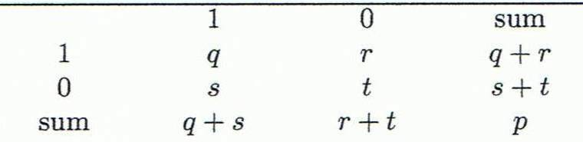

Proximity Measure for Binary Attributes
A contingency table for binary data
Distance measure for symmetric binary variables:
A binary symmetric variable is said to be symmetric if both of its states are of the same value and carry the same weight, and there is no preference as such as which outcome should be mapped to 0 or mapped to 1. e.g. attribute of gender.
Distance measure for asymmetric binary variables
Jaccard coefficient (similarity measure for asymmetric binary variables): Note: Jaccard coefficient is the same as “coherence”
Object j
Object i
A = {0,1,2,5,6}
B = {0,2,3,4,5,7,9}
Solution: J(A,B) = |A∩B| / |A∪B| = |{0,2,5}| / |{0,1,2,3,4,5,6,7,9}| = 3/9 = 0.33.
Jaccard Index = (the number in both sets) / (the number in either set) * 100
J(X,Y) = |X∩Y| / |X∪Y|
Note- Apply jaccard similarity where cardinality i.e. number of elements of each type matter.

Slide 63
Dissimilarity between Binary Variables
Example
Gender is a symmetric attribute
The remaining attributes are asymmetric binary
Let the values Y and P be 1, and the value N 0
 | Gender | fever | Cough | Test-1 | Test-2 | Test-3 | Test-4
Jack | M | 1 | 0 | 1 | 0 | 0 | 0
Mary | F | 1 | 0 | 1 | 0 | 1 | 0
Jim | M | 1 | 1 | 0 | 0 | 0 | 0
 | Mary
Jack | 1 | 0 |  | D(jack,Mary) |  | q/ q+r+s
1 | 2 | 0 |  |  |  | 0.66666
0 | 1 | 3
https://en.wikipedia.org/wiki/Jaccard_index
https://www.statisticshowto.datasciencecentral.com/jaccard-index/

Slide 64

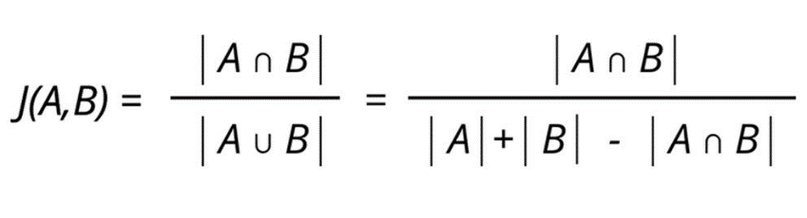
Jaccard Similarity Index (1/2)
• Jaccard Similarity Index compares members for two sets to see which
members are shared and which are distinct.
• It’s a measure of similarity for the two sets of data, with a range from 0% to
100%. The higher the percentage, the more similar the two populations.
• The formula to find the Jaccard Similarity Index is:
Jaccard Index = (the number in both sets) / (the number in either set)
Sources: https://www.statisticshowto.datasciencecentral.com/jaccard-index/
http://techinpink.com/2017/08/04/implementing-similarity-measures-cosine-similarity-versus-jaccard-similarity/
8
BAZG523(Introduction to Data Science)

Slide 65
Jaccard Similarity Index (2/2)
Example
• There are two strings A and B:
[How, Can, I, Be, A, Geologist, What, Should, Do, To]
A = "How can I be a geologist?"
B = "What should I do to be a geologist?"
A ∩ B = ['a', 'be', 'geologist?', 'i']
A U B = ['a', 'be', 'geologist?', 'to', 'do', 'i', 'what', 'should', 'how', 'can’]
|A ∩ B| = 4 (Cardinality of the elements in the intersection of A and B)
|A
B| = 10 (Cardinality of the elements in the union of A and B)
Jaccard Similarity = |A ∩ B| : |A U B|
= 4:10
= 0.40
Sources: https://www.statisticshowto.datasciencecentral.com/jaccard-index/
http://techinpink.com/2017/08/04/implementing-similarity-measures-cosine-similarity-versus-jaccard-similarity/
9
BAZG523(Introduction to Data Science)

Slide 66
Standardizing Numeric Data: Ordinal, Interval, Ratio
Z-score:
X: raw score to be standardized, μ: mean of the population, σ: standard deviation
the distance between the raw score and the population mean in units of the standard deviation
negative when the raw score is below the mean, “+” when above
An alternative way: Calculate the mean absolute deviation
where
standardized measure (z-score):
Using mean absolute deviation is more robust than using standard deviation
Notes:
MK: For lecture, this may be OK here, but I think discussion of standardization/normalization is better kept all together in Chapter 3

Slide 67
Ordinal Variables
An ordinal variable can be discrete or continuous
Order is important, e.g., rank
Can be treated like interval-scaled
replace x_{if} by their rank
map the range of each variable onto [0, 1] by replacing i-th object in the f-th variable by
compute the dissimilarity using methods for interval-scaled variables

Slide 68
Ratio-Scaled Variables
Ratio-scaled variable: a positive measurement on a nonlinear scale, approximately at exponential scale, such as Ae^{Bt} or Ae^{-Bt}
Methods:
treat them like interval-scaled variables — not a good choice! (why?)
apply logarithmic transformation
y_{if} = log(x_{if})
treat them as continuous ordinal data treat their rank as interval-scaled.

Slide 69
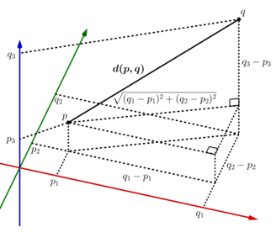
Proximity Measures on Numeric Data: Data Matrix and Dissimilarity Matrix
Data Matrix
Euclidean distance or Euclidean metric is the "ordinary" straight-line distance between two points in Euclidean space. With this distance, Euclidean space becomes a metric space. The associated norm is called the Euclidean norm. Older literature refers to the metric as the Pythagorean metric. A generalized term for the Euclidean norm is the L² norm or L² distance.
Dissimilarity Matrix
(with Euclidean Distance)
https://en.wikipedia.org/wiki/Euclidean_distance

Slide 70
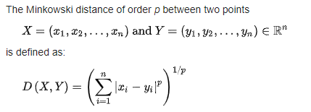
Distance on Numeric Data: Minkowski Distance
https://iq.opengenus.org/minkowski-distance/
Minkowski distance: A popular distance measure
Properties
d(i, j) > 0 if i ≠ j, and d(i, i) = 0 (Positive definiteness)
d(i, j) = d(j, i) (Symmetry)
d(i, j) ≤ d(i, k) + d(k, j) (Triangle Inequality)
A distance that satisfies these properties is a metric
Minkowski distance is a distance/ similarity measurement between two points in the normed vector space (n- dimensional real space) and is a generalization of the Euclidean distance and the Manhattan distance.
Here p = L_{p} –norm, where p = -∞ to + ∞

Slide 71
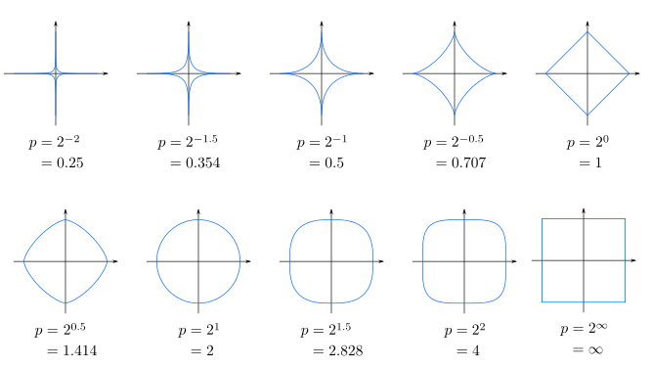
Minkowski Distance

Slide 72
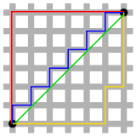

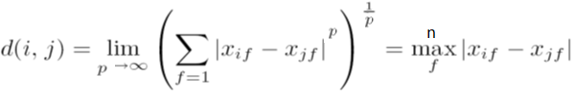
Special Cases of Minkowski Distance
p = 1: Manhattan (city block, L₁ norm) distance
Hamming distance : The distance between two points measured along axes at right angles. In a plane with p1 at (x1, y1) and p2 at (x2, y2), it is |x1 - x2| + |y1 - y2|.
In n-dim data points,
d(i, j) = |x_{i1} – x_{j1}|+ |x_{i2} – x_{j2}|+ |x_{i3} – x_{j3}|+… |x_{in} – x_{jn}|
p = 2: (L₂ norm) Euclidean distance
p → ∞. “supremum” (L_{max} norm, L∞ norm) distance.
This is the maximum difference between any component (attribute) of the vectors
Red: Manhattan distance.
Green: Euclidean distance
Red, blue, yellow: equivalent Manhattan distances.

Slide 73
Example: Minkowski Distance
(Dissimilarity Matrices)
Manhattan (L₁)
Euclidean (L₂)
Supremum

Slide 74
Attributes of Mixed Type
A database may contain all attribute types
Nominal, symmetric binary, asymmetric binary, numeric, ordinal
One may use a weighted formula to combine their effects
f is binary or nominal:
d_{ij}^{(f)} = 0 if x_{if} = x_{jf} , or d_{ij}^{(f)} = 1 otherwise
f is numeric: use the normalized distance
f is ordinal
Compute ranks r_{if} and
Treat z_{if} as interval-scaled

Slide 75
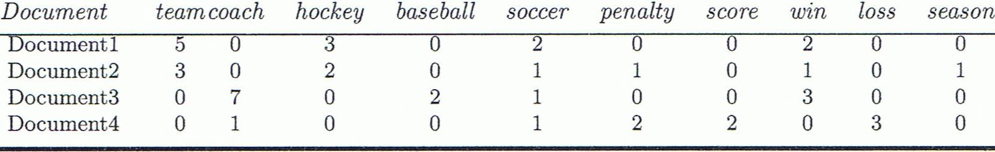
Cosine Similarity (1/6)
A document can be represented by thousands of attributes, each recording the frequency of a particular word (such as keywords) or phrase in the document.
Other vector objects: gene features in micro-arrays, …
Applications: information retrieval, biologic taxonomy, gene feature mapping, ...
Cosine measure: If d₁ and d₂ are two vectors (e.g., term-frequency vectors), then
cos(d₁, d₂) = (d₁ • d₂) /||d₁|| ||d₂|| ,
where • indicates vector dot product, ||d||: the length of vector d
Notes:
MK: Machine learning used the term “feature VECTORS” > I made some changes to the wording of this slide because it implied that our previous data were not vectors, but they were all feature vectors. I also changed the example since the one used was from Tan’s book (see next slide).
Chapter 3: Statistics Methods
Co-variance distance
K-L divergence

Slide 76
Example: Cosine Similarity
cos(d₁, d₂) = (d₁ • d₂) /||d₁|| ||d₂|| ,
where • indicates vector dot product, ||d|: the length of vector d
Ex: Find the similarity between documents 1 and 2.
d₁ = (5, 0, 3, 0, 2, 0, 0, 2, 0, 0)
d₂ = (3, 0, 2, 0, 1, 1, 0, 1, 0, 1)
d₁•d₂ = 5*3+0*0+3*2+0*0+2*1+0*1+0*1+2*1+0*0+0*1 = 25
||d₁||= (5*5+0*0+3*3+0*0+2*2+0*0+0*0+2*2+0*0+0*0)^{0.5}=(42)^{0.5} = 6.481
||d₂||= (3*3+0*0+2*2+0*0+1*1+1*1+0*0+1*1+0*0+1*1)^{0.5}=(17)^{0.5} = 4.12
cos(d₁, d₂ ) = 0.94
Notes:
09/09/25MK: New example (previous one was from Tan’s book).
Chapter 3: Statistics Methods
Co-variance distance
K-L divergence

Slide 77
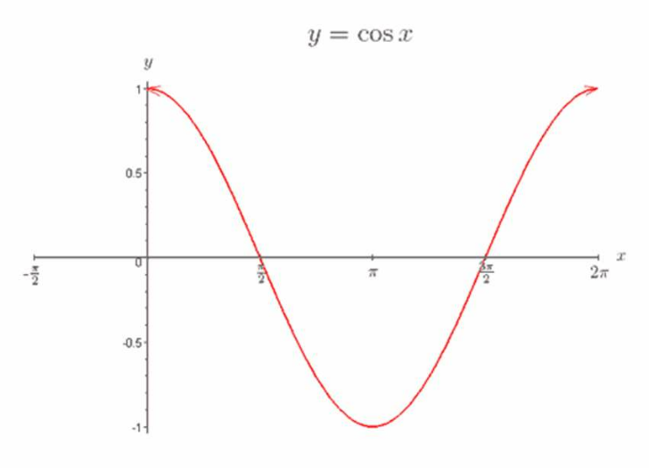
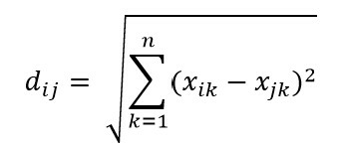
Cosine Similarity (2/6)
• Cosine Similarity between two vectors is a measure that calculates the
Cosine of the angle between them.
• This metric is a measurement of orientation and not magnitude, for which
we calculate the Euclidean Distance.
• Euclidian Distance is the linear distance between two points in multi-
dimensional hyper-space. Euclidian distance for point i and point j in n-
dimensional space can be computed as:
Sources: http://blog.christianperone.com/2013/09/machine-learning-cosine-similarity-for-vector-space-models-part-iii/
https://www.machinelearningplus.com/nlp/cosine-similarity/
https://www.edupristine.com/blog/curse-dimensionality
3
BAZG523(Introduction to Data Science)

Slide 78



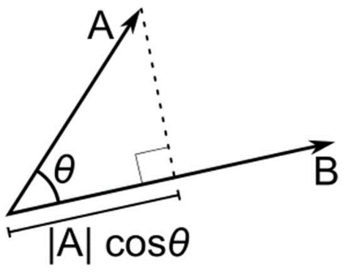
Cosine Similarity (3/8)
Dot Product
• There are two vectors as follows, each with n dimensions:
• The dot product is a simple multiplication of each component from the both
vectors added together.
• Dot product may be understood geometrically as the projection of one vector
onto another, multiplied by the length of the vector that it is projected onto.
Sources: http://blog.christianperone.com/2013/09/machine-learning-cosine-similarity-for-vector-space-models-part-iii/
https://www.machinelearningplus.com/nlp/cosine-similarity/
https://www.edupristine.com/blog/curse-dimensionality
4
BAZG523(Introduction to Data Science)

Slide 79
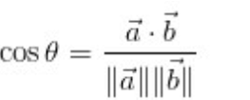
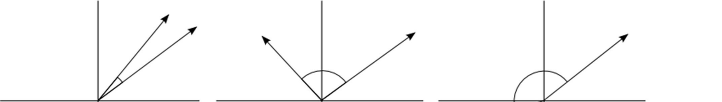
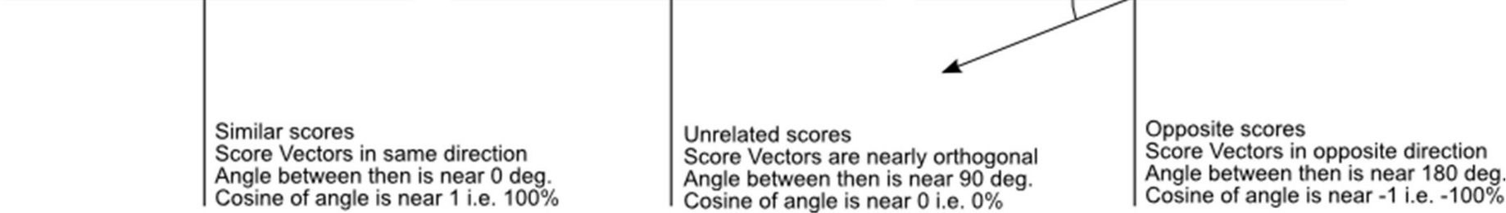
Cosine Similarity (4/6)
• Cosine Similarity between two vectors is a measure that calculates the
Cosine of the angle between them.
Sources: http://blog.christianperone.com/2013/09/machine-learning-cosine-similarity-for-vector-space-models-part-iii/
https://www.machinelearningplus.com/nlp/cosine-similarity/
https://www.edupristine.com/blog/curse-dimensionality
5
BAZG523(Introduction to Data Science)

Slide 80
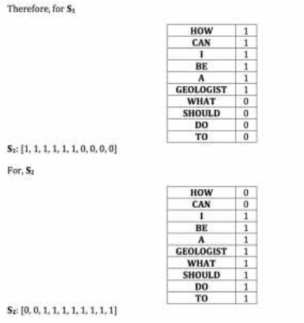
Cosine Similarity (5/6)
Example
• There are two strings text1 and text2:
text1 = 'How can I be a geologist?'
text2 = 'What should I do to be a
geologist?’
• Vector Space, which is a set (unique
values) after combining all the words in
both strings:
[How, Can, I, Be, A, Geologist, What,
Should, Do, To]
• From the table on the right, we create the
document matrices as below:
text1 = [1, 1, 1, 1, 1, 1, 0, 0, 0, 0]
text2 = [0, 0, 1, 1, 1, 1, 1, 1, 1, 1]
Sources: http://techinpink.com/2017/08/04/implementing-similarity-measures-cosine-similarity-versus-jaccard-similarity/
6
BAZG523(Introduction to Data Science)

Slide 81
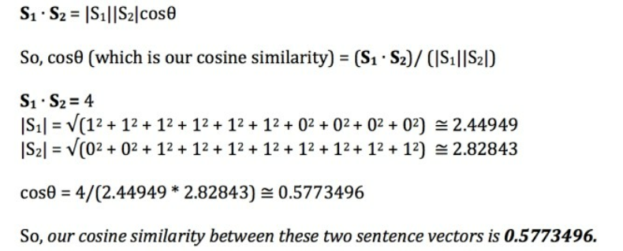
Cosine Similarity (6/6)
Example (continued)
• Following is the calculation of Cosine similarity:
Sources: http://techinpink.com/2017/08/04/implementing-similarity-measures-cosine-similarity-versus-jaccard-similarity/
7
BAZG523(Introduction to Data Science)

Slide 82
Prescribed Text Books
 | Author(s), Title, Edition, Publishing House
T1 | Tan P. N., Steinbach M & Kumar V. “Introduction to Data Mining” Pearson Education
T2 | Data Mining: Concepts and Techniques, Third Edition by Jiawei Han, Micheline Kamber and Jian Pei Morgan Kaufmann Publishers

